Slide 1
BELGIUM · RESIDENTIAL
Where to Invest in
Belgian Real Estate
A data-driven recommendation built on 12,600+ market listings — what drives value, and where the opportunity sits.
12,600+
3 regions
>2×
listings analysed
Flanders · Wallonia · Brussels
prestige-location premium
PREPARED FOR INVESTOR REVIEW

Slide 2




EXECUTIVE SUMMARY
Size and location set the price — prestige sets it apart
Size is the #1 driver
Location is the multiplier
Energy class is the tie-breaker
Living area, bedrooms and total surface dominate price. Underwrite on usable square metres before anything else.
A north/urban gradient runs through the market. Proximity to a prestigious city more than doubles comparable house prices.
EPC rating ranks just behind size and location — A-rated stock commands a premium and de-risks future regulation.
OUR RECOMMENDATION
Target well-sized, energy-efficient homes on the rising edge of prestigious city catchments — and buy smaller units near cities for the strongest price per m².

Slide 3




HOW WE BUILT THE EVIDENCE
A clean, defensible dataset — not a scrape dump
01
02
03
04
Raw market data
Non-destructive cleaning
Flag, don't delete
Analysis-ready features
12,600+ Belgian for-sale listings across houses and apartments, scraped nationwide with price, surface, location, energy and amenities.
An 8-step pipeline standardises categories and fixes only indisputable errors (e.g. GPS swaps confirmed by postal code).
Implausible prices, areas and years are flagged for review rather than silently removed — nothing is quietly massaged.
Ordered EPC/condition scales, boolean amenities and a derived price-per-m² enable like-for-like comparison.
Why it matters for you: every number in this deck is traceable to a clean, auditable record — diligence starts on solid ground.

Slide 4
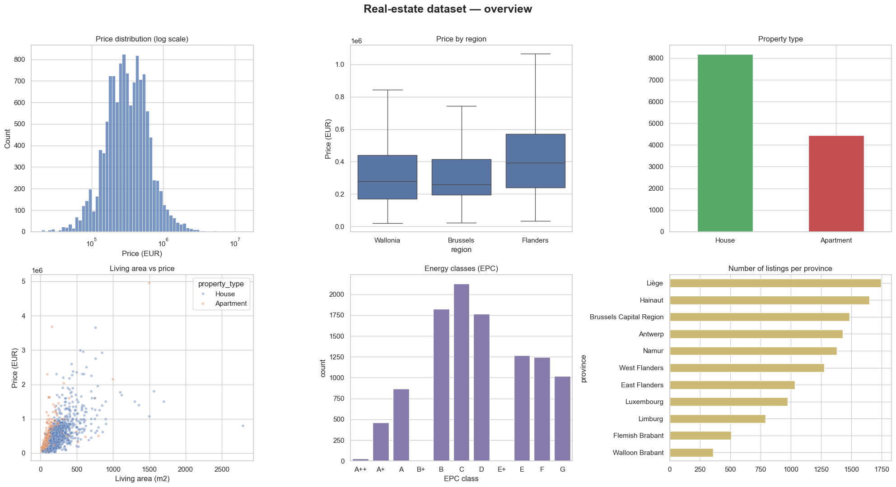
THE MARKET AT A GLANCE
Two-thirds houses, prices skew right, energy is middling
Flanders leads
Highest median prices by region; Wallonia and Brussels sit below.
Houses dominate
~8,200 houses vs ~4,400 apartments — a house-led market.
Energy is average
Most stock clusters at C–D; A-rated homes are scarce and prized.
Right-skewed prices
A long tail of premium assets pulls the average above the median.

Slide 5
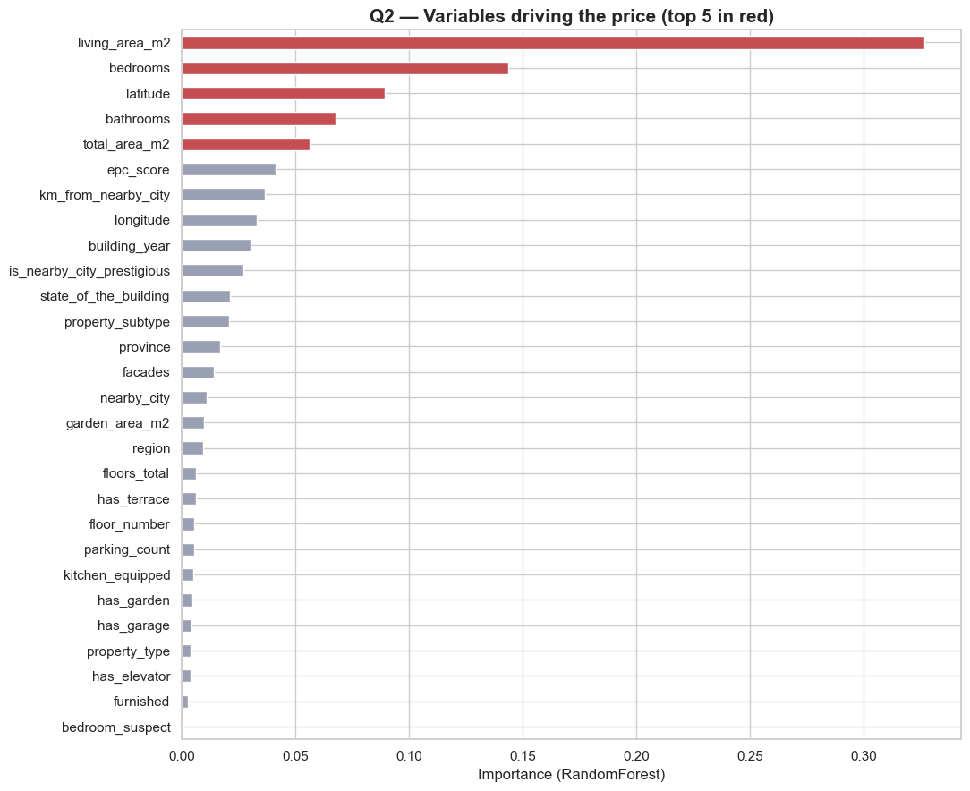



WHAT ACTUALLY MOVES PRICE
Size, then location, then energy
A Random-Forest model ranks every variable by its contribution to price.
Size dominates
Living area, bedrooms, bathrooms and total surface take the top spots — usable space is the price engine.
Location is decisive
Latitude (the north/south, urban/rural gradient) is the strongest non-size factor.
Energy ranks high
EPC score sits just behind — a real, monetisable lever as regulation tightens.

Slide 6
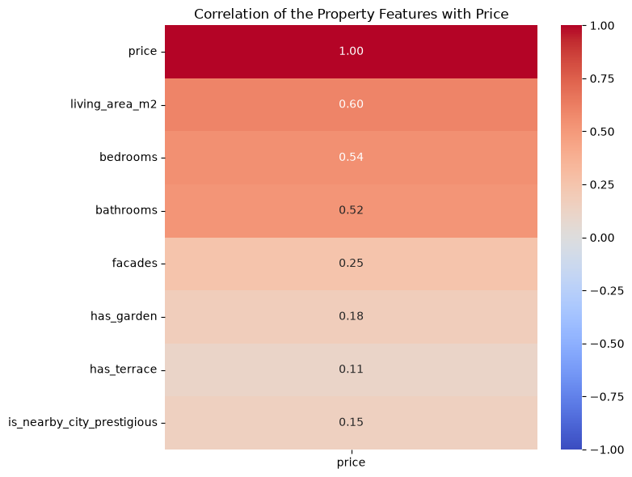
THE CORRELATION CROSS-CHECK
A simpler lens, the same verdict
Plain correlation with price confirms the model — and exposes what doesn't move it.
Functional space drives price
0.60
Living area
0.54
Bedrooms
0.52
Bathrooms
Structure adds a little
0.25
Facades
Cosmetic features barely register
0.18
Garden
0.15
Prestige flag
0.11
Terrace
For the investor: underwrite on m² and rooms, not gardens or terraces. (Garage dropped — too many missing values to trust.)

Slide 7
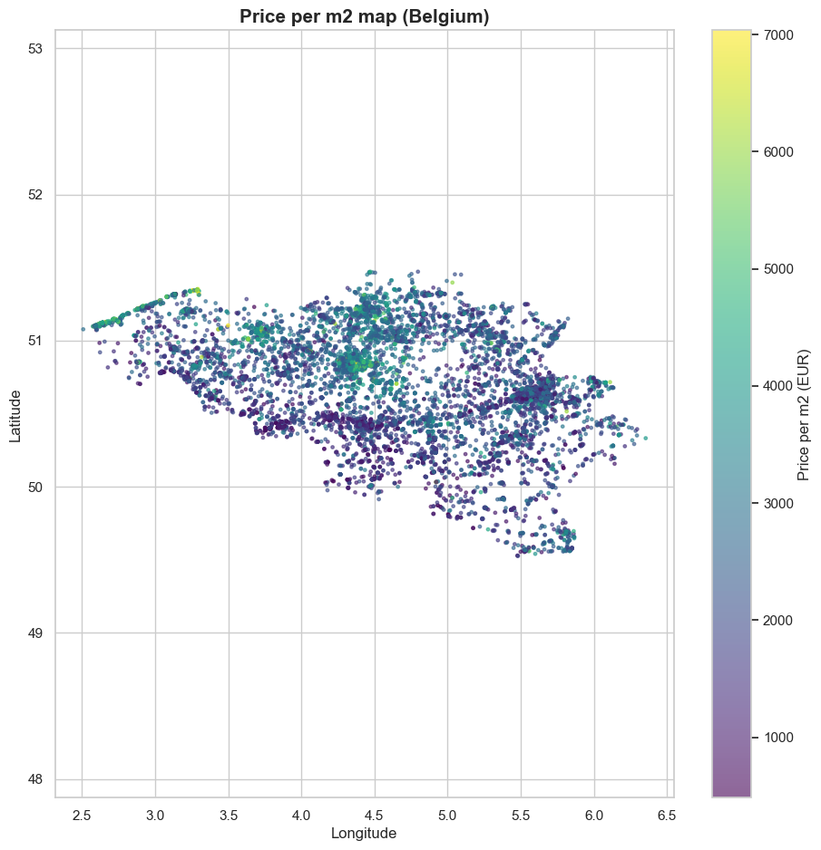
THE GEOGRAPHY OF VALUE
Price per m² is concentrated, not uniform
Hotspots cluster
The brightest €/m² values concentrate around the coast and major urban cores, not evenly across the map.
A north–south gradient
Northern and central belts carry higher per-m² values; large rural stretches trade at a discount.
Micro-markets matter
Value is local. National averages hide pockets where €/m² is double the surrounding area.

Slide 8
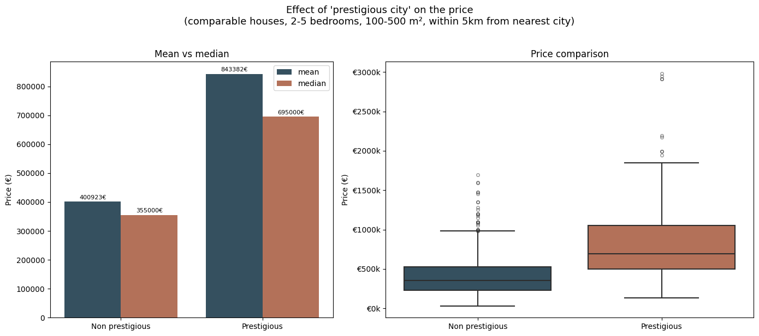
THE PRESTIGE PREMIUM
Proximity to a prestigious city more than doubles price
Comparable houses only — 2–5 bedrooms, 100–500 m², within 5 km from the nearest city — so the gap reflects location, not size.
+110%
higher mean price near a prestigious city
€843k
vs €403k — like-for-like houses
€3,612/m²
near prestige vs €2,070 elsewhere
Note: prestigious sample is small (n≈199) — directionally strong, worth validating per target area.

Slide 9
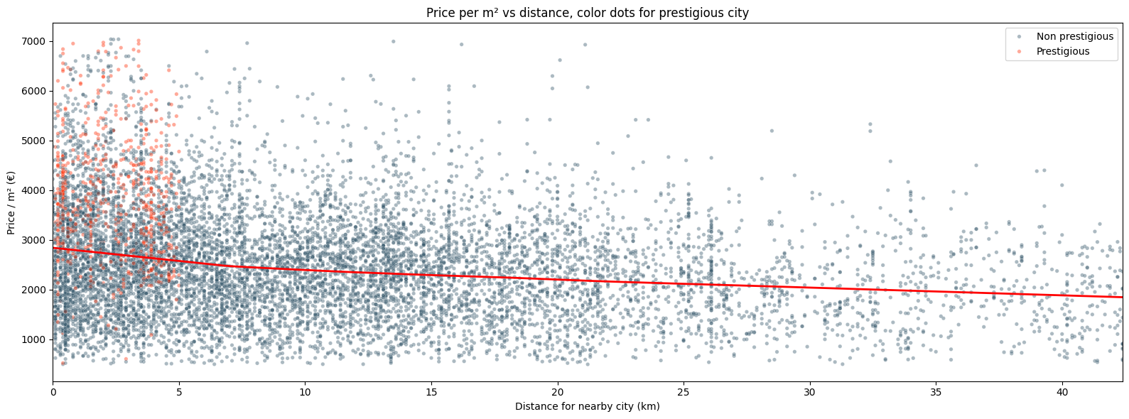

DISTANCE & DENSITY DYNAMICS
The yield play: small units, close to cities
€/m² falls with distance
Smaller = pricier per m²
Where the yield sits
Price per m² declines steadily as you move away from a city (correlation ≈ −0.26). The premium is paid for access.
Studios and small apartments fetch the highest €/m²; large homes spread fixed value over more surface.
Compact, well-located units combine the strongest €/m² with the deepest tenant demand — a rental-yield sweet spot.

Slide 10

WHERE VALUE SITS
Premium cores vs. value provinces
MOST EXPENSIVE
€4,509/m²
€3,942/m²
Reading the spread
Brussels — priciest per m² for compact homes
Average near a prestigious city
Brussels stays the most expensive market at every size bracket — a capital-preservation play, not a yield one.
BEST VALUE ENTRY
Prestige-adjacent locations carry a durable ~60% €/m² premium over the rest of the country.
Hainaut
Namur
Hainaut and Namur offer the lowest entry prices — the value end for buy-renovate-rent strategies.
Cheapest for small–mid homes (0–200 m²)
Cheapest for larger homes (200–500 m²)

Slide 11
FROM REGIONS TO STREETS
Zoom in: named winners and a Brussels gradient
MOST EXPENSIVE MUNICIPALITIES
MOST AFFORDABLE MUNICIPALITIES
1
Kraainem
1
Blaimont
Prestigious Brussels periphery
Small rural Wallonian village
2
Sterrebeek
2
Baileux
Affluent commuter belt, east of Brussels
Thin market, very few transactions
3
Knokke-Heist
3
Rural Wallonia
Premium coastal resort market
Large stretches priced well below the cores
THE DISTANCE-TO-BRUSSELS GRADIENT
The farther you move from the capital, the cheaper property gets. Value concentrates in the Brussels periphery and along the coast — and even the cheapest Brussels commune outprices most of Wallonia.

Slide 12
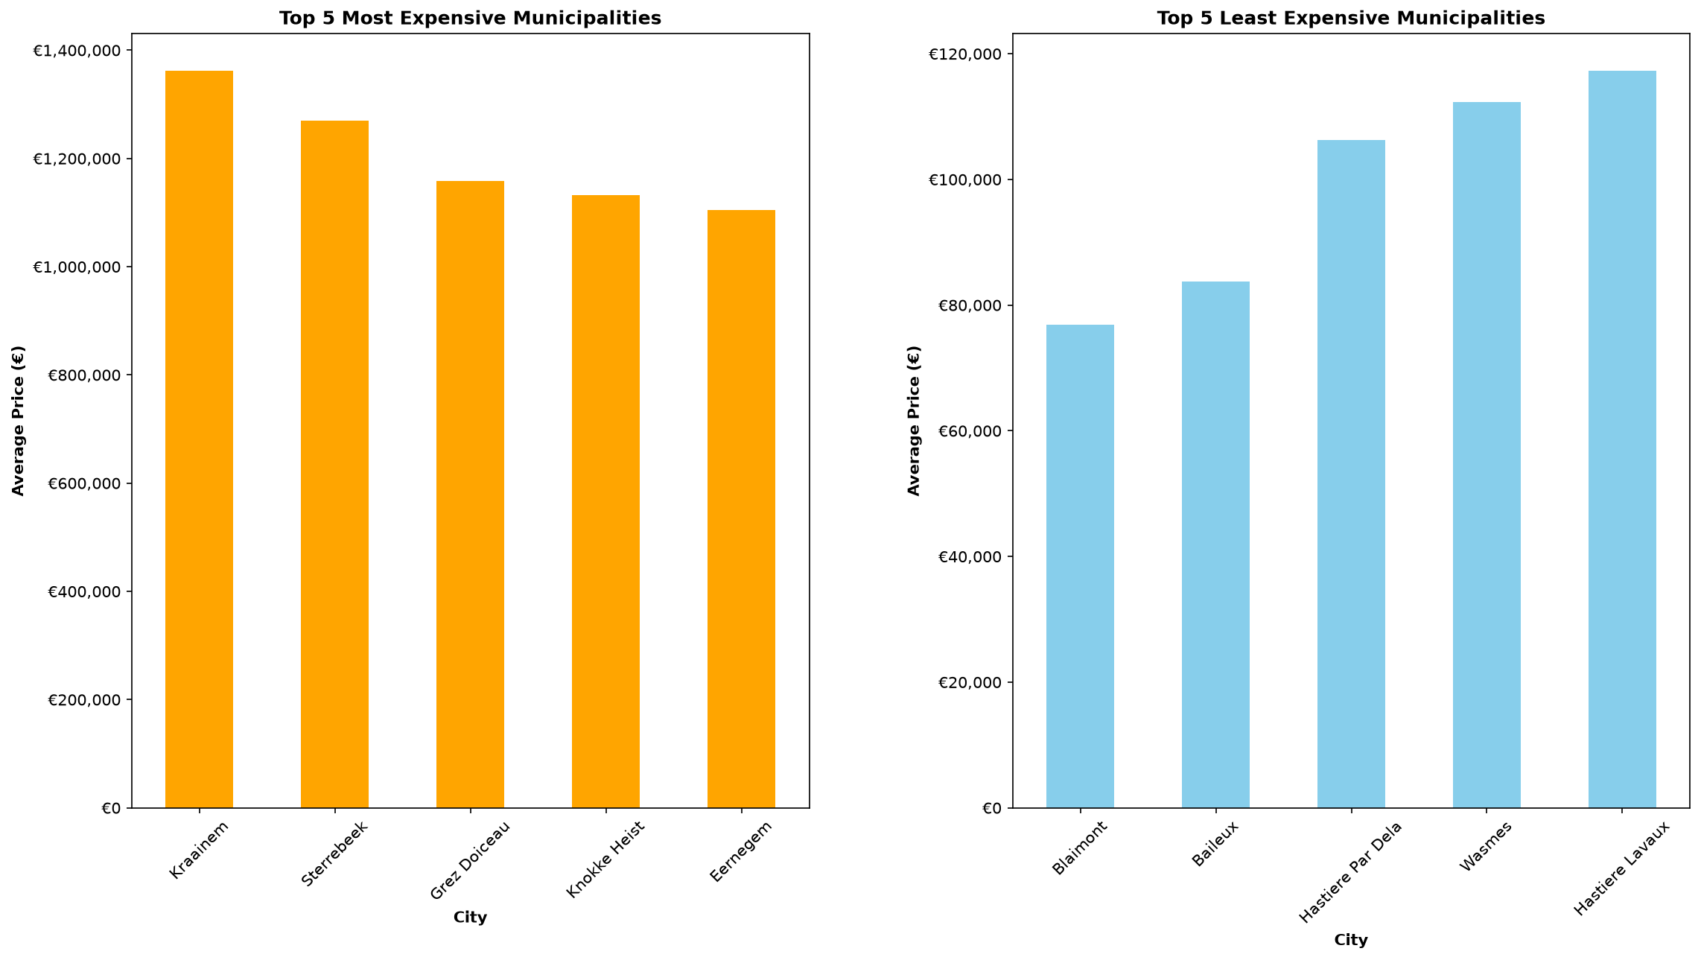
FROM REGIONS TO STREETS
Where prices peak — and bottom out
The same names the previous slide flagged — now sized by average price.
THE MUNICIPAL SPREAD Kraainem leads near €1.4M average, while rural Wallonian villages bottom out below €80k — a gap of almost 18× between the priciest and cheapest municipalities.

Slide 13

READING THE REGIONAL CHARACTER
A market in three speeds
Brussels
Flemish periphery
Wallonia
URBAN CORE
COMMUTER BELT
RURAL VALUE
€/m²
Total price
Price
Highest — small flats, high demand
Highest — strong purchasing power
Lowest overall, larger plots
Demand
Demand
Demand
Stable & mature, low variation
Pulled up by proximity to Brussels
Thinner — fewer active buyers
Risk
Risk
Risk
Low — consistently priced
Moderate — premium already priced
Higher — liquidity & demand
Capital preservation
Growth / appreciation
Value — with demand risk
Read it right: median beats average (luxury outliers skew the mean), and price/m² flips the ranking — small Brussels flats outrank large rural villas. Where you buy matters more than what you buy.

Slide 14
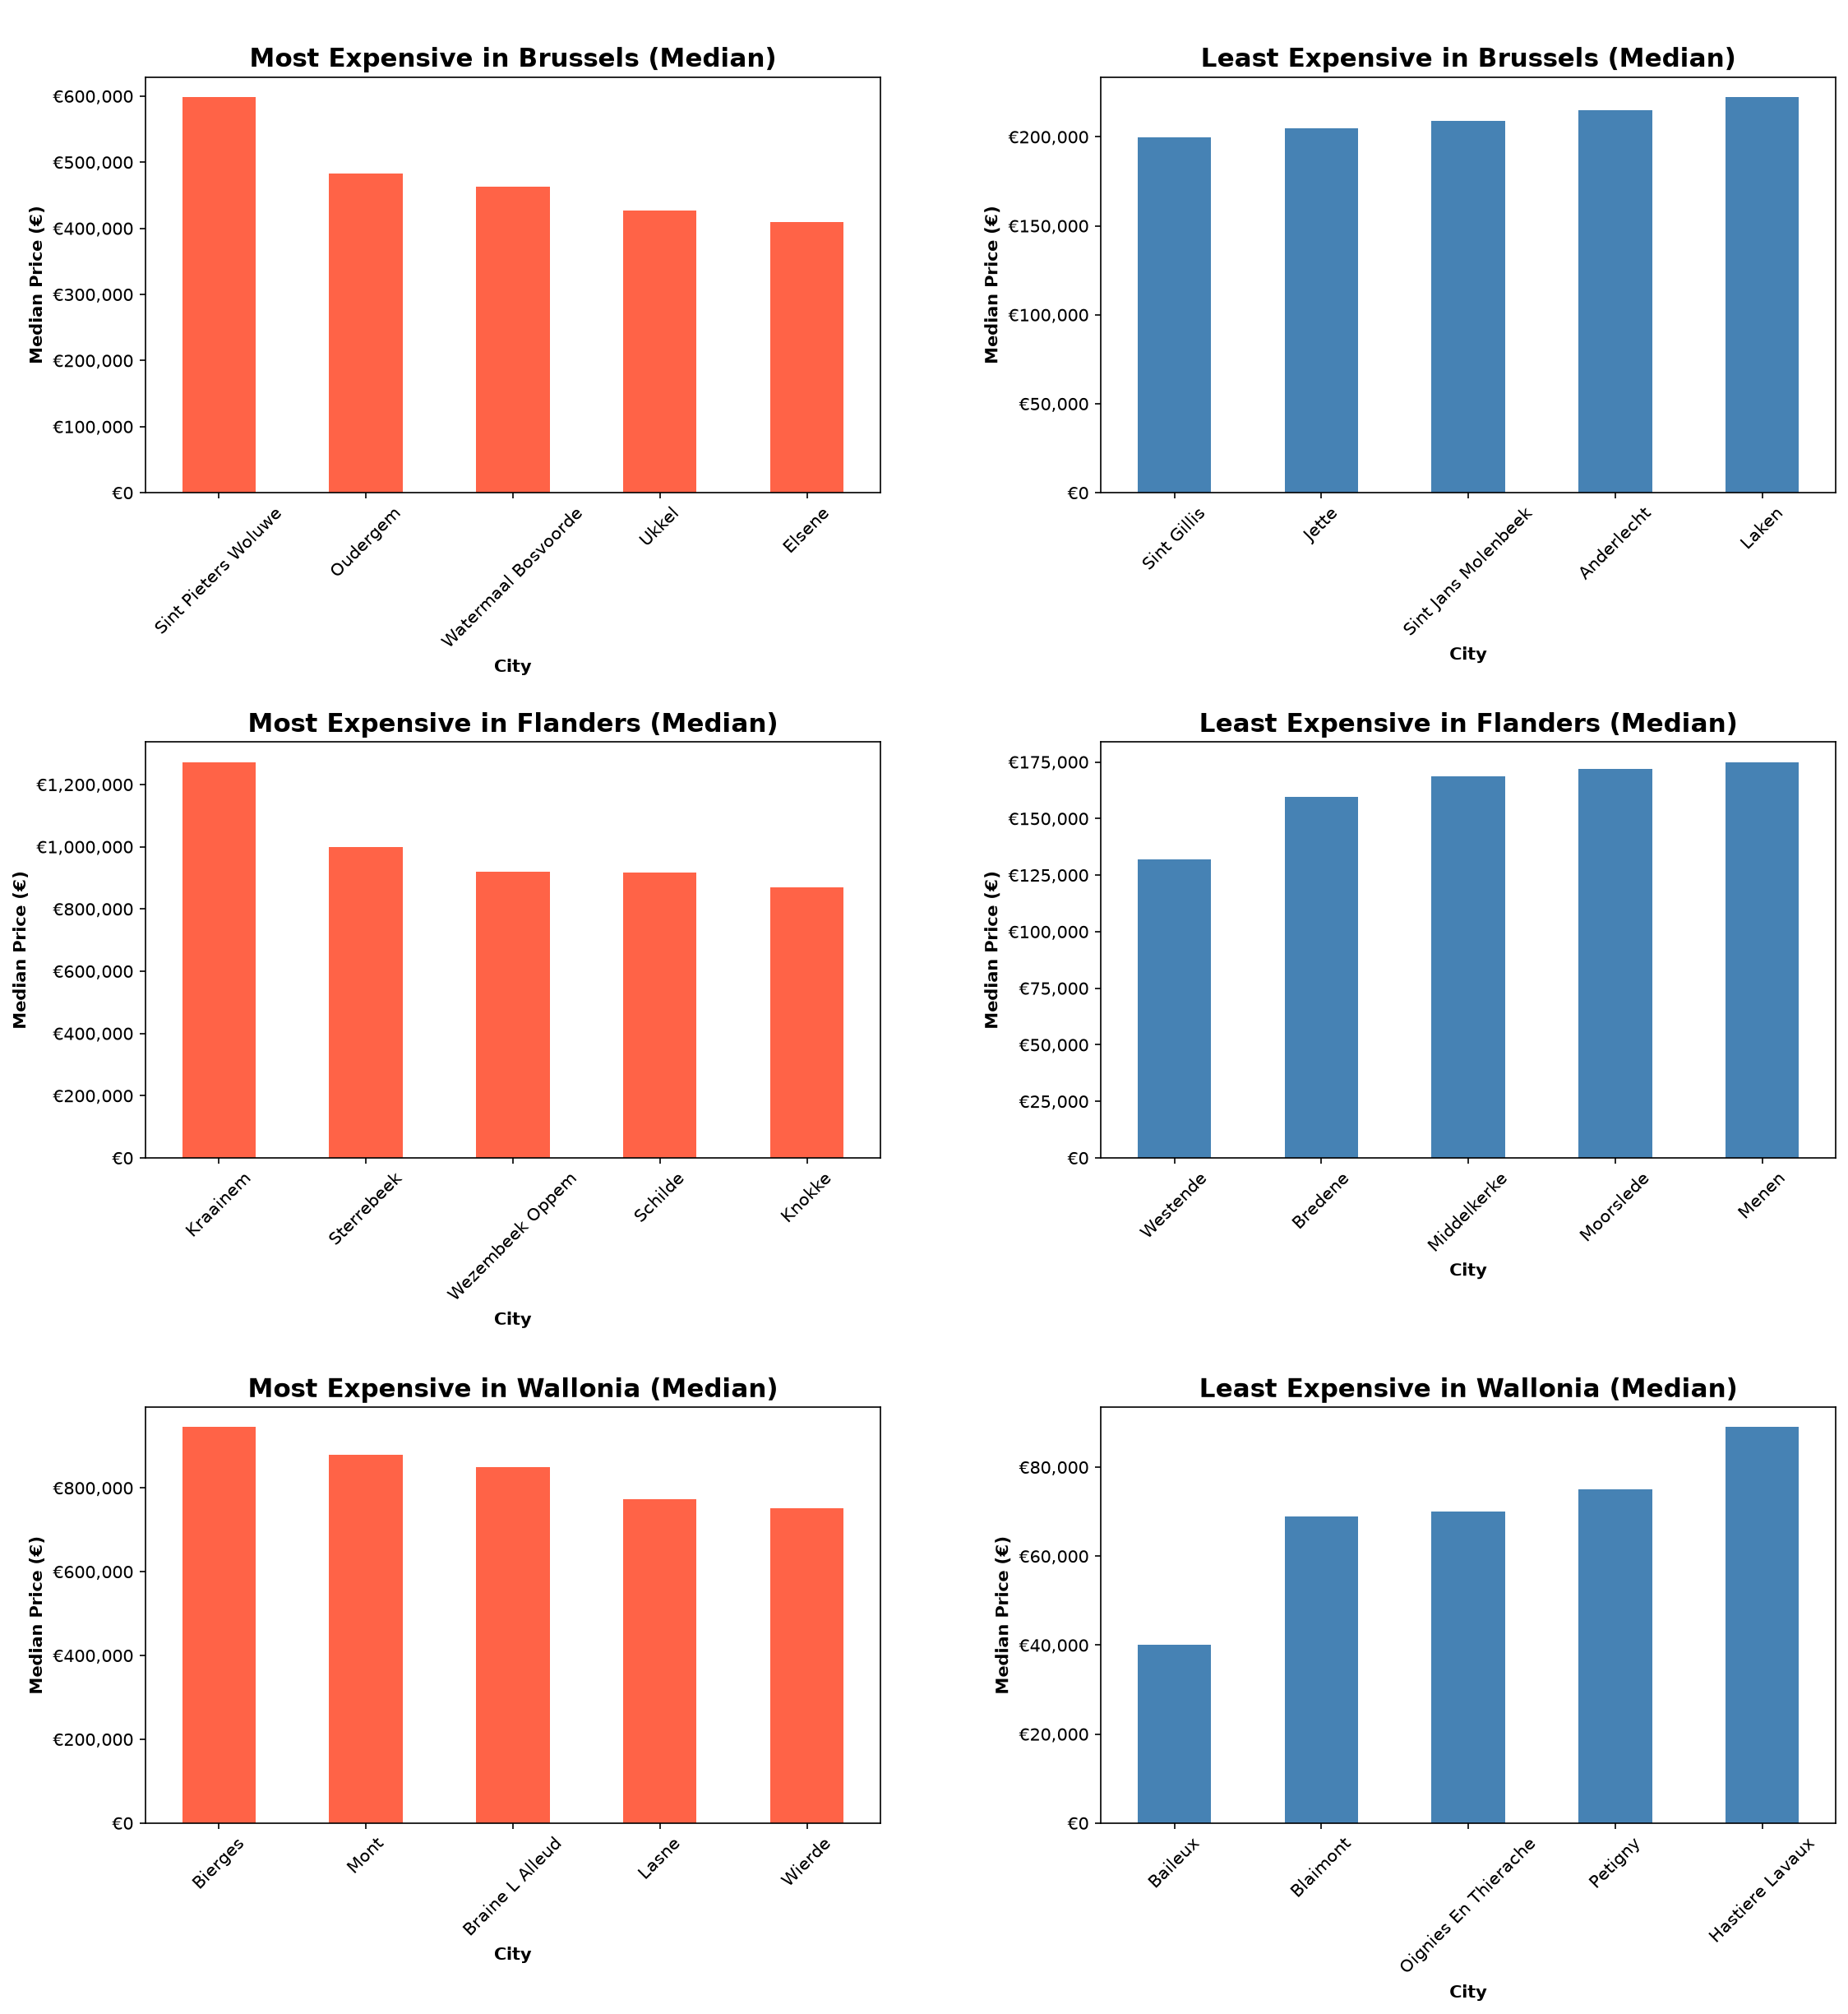
READING THE REGIONAL CHARACTER
Median tells the truer story
Stripping out luxury outliers reshuffles the ranking region by region.
Brussels — tight band
Even the cheapest communes hold near €200k median.
Flanders — widest range
From Kraainem (~€1.26M) down to coastal towns (~€130k).
Wallonia — the entry point
Baileux and Blaimont sit lowest, around €40–€70k median.
Median sits below the average everywhere
— the mean is inflated by a thin luxury tail.

Slide 15


INVESTMENT RECOMMENDATION
Three plays the data supports
01
02
03
Prestige-edge growth
Compact urban yield
Energy arbitrage
Well-sized family houses on the rising edge of prestigious city catchments.
Smaller apartments within ~5 km of city centres.
Buy C–D stock in strong locations, renovate to A/B.
Why: Capture the >2× location premium before it fully prices in.
Why: Highest €/m² and strongest rental demand — built for cash yield.
Why: Monetise the EPC premium and de-risk tightening regulation.
Common thread: buy usable size, in the right location, with a credible energy story.

Slide 16

RISKS & DILIGENCE NOTES
What to validate before you commit
Listing prices ≠ sold prices
Thin prestige sample
The dataset reflects asking prices. Calibrate against realised transaction data before final underwriting.
The prestige premium rests on ~199 comparable houses — strong signal, but validate area-by-area.
Missing fields in places
Correlation, not causation
Some columns are sparsely populated (e.g. garden area ~78% missing); treat those features with caution.
The model ranks associations with price, not guaranteed returns. Local market dynamics still rule.

Slide 17

The opportunity, in one line
Buy usable size, in rising prestigious catchments, with an energy upside.
RECOMMENDED NEXT STEPS
1. Shortlist
2. Validate
3. Model
Define 2–3 target catchments on the prestige edge.
Benchmark against sold-price data for those areas.
Build yield & EPC-renovation scenarios per asset.
Belgian Residential Real Estate · Investment Recommendation
Built on 12,600+ analysed listings

